Slide 1
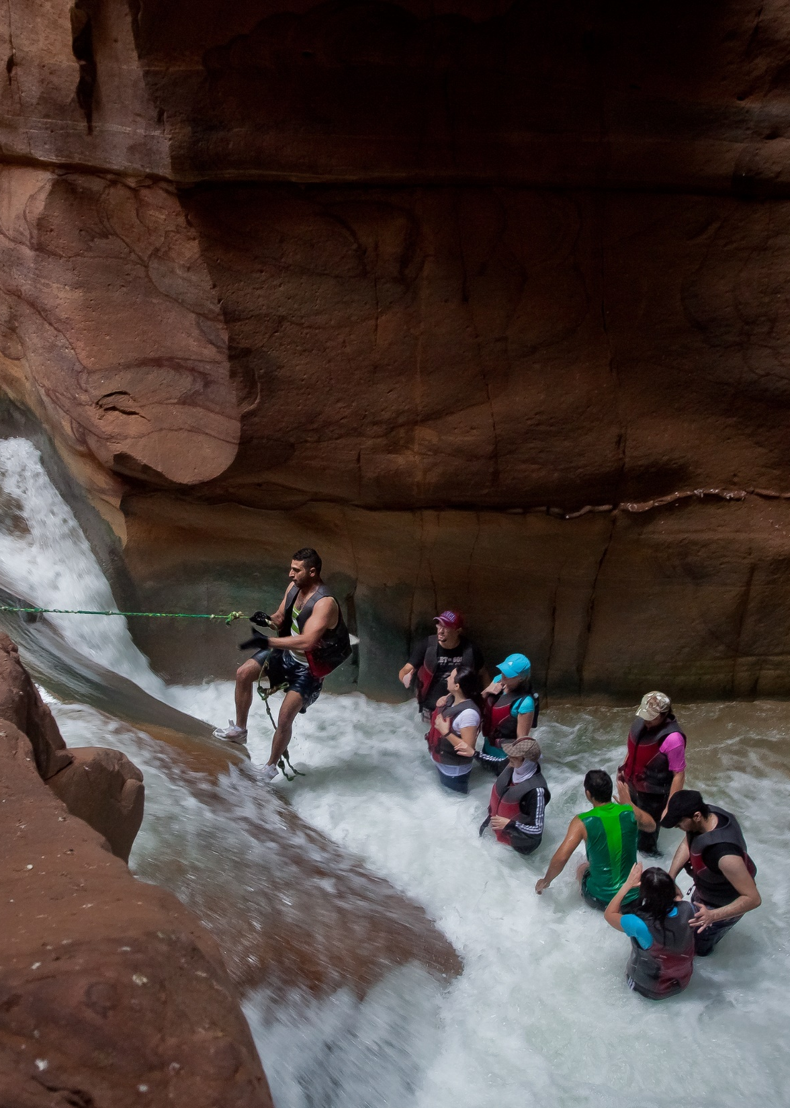
SESSION 4:
Marketing Tools & Channels of the Mediterranean Adventures
Lutecia Beainy Bouchabke, Communication Coordinator MEDUSA

Slide 2

Marketing tools: the Overview
Mediterranean Adventures
Flyers - 1 general flyer introducing all five destinations & 5 destination flyers – one for each destination
Picture gallery and videos - representing each destination’s sustainable adventure tourism activities, authenticity and local people
Hiking guides for each destination
Social media campaign – starting in September 2022
Web portal with the marketing content and a member area

Slide 3







Branding elements
Mediterranean Adventures

Slide 4
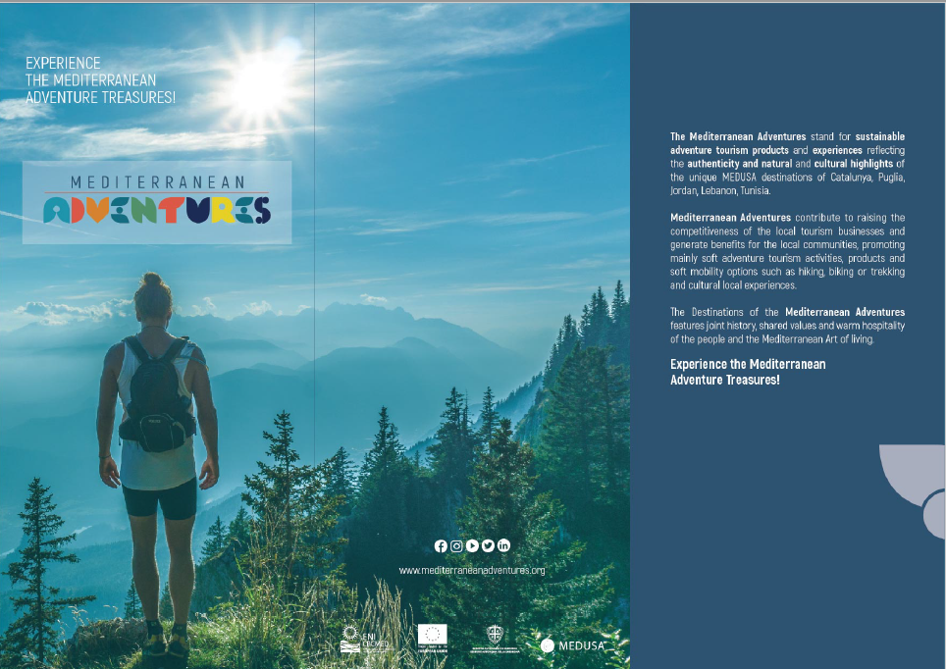
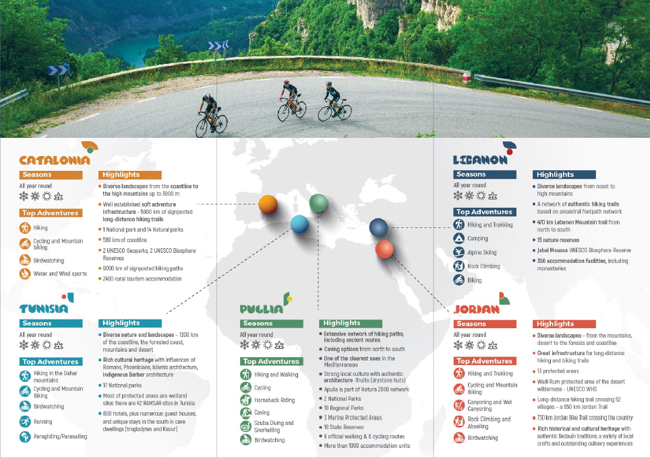
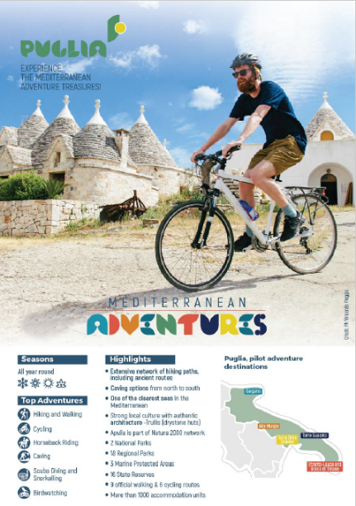
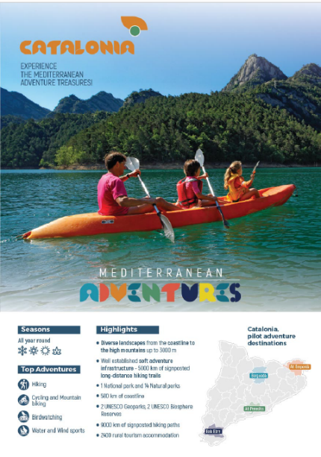
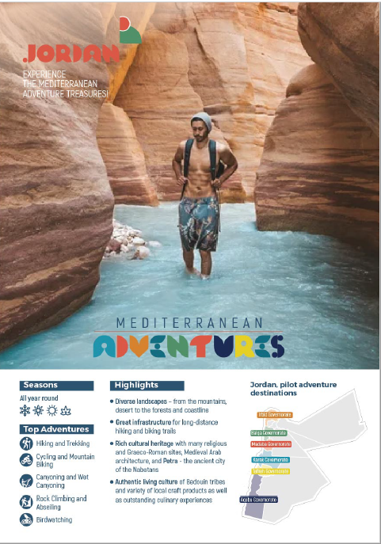
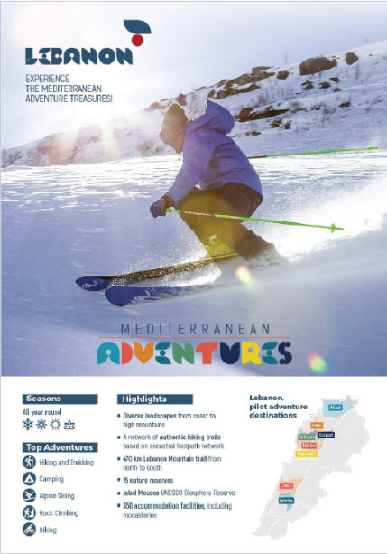
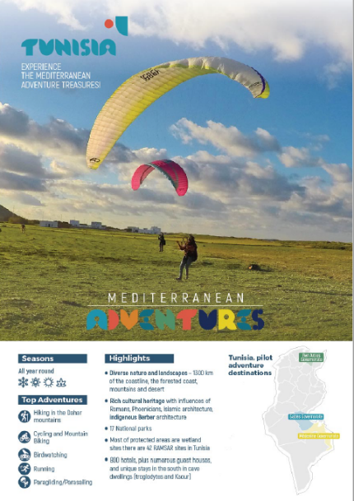
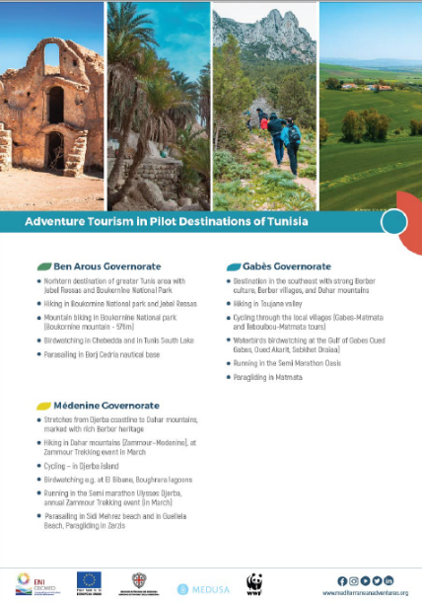
1. Flyers
Mediterranean Adventures
1 general flyer introducing all five destinations
5 destination flyers – one for each destination

Slide 5
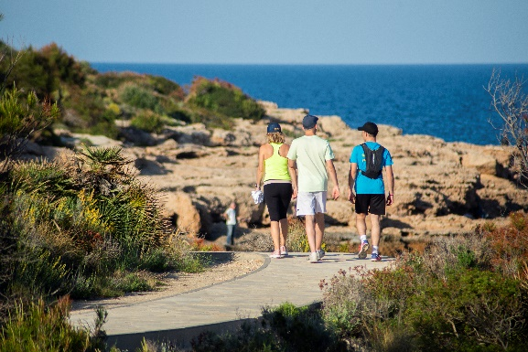
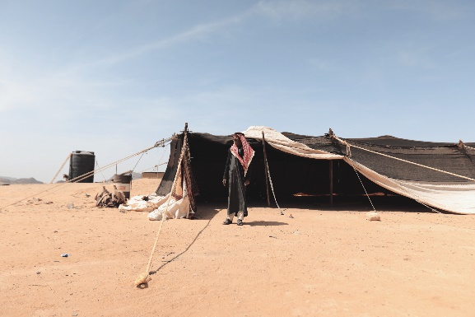
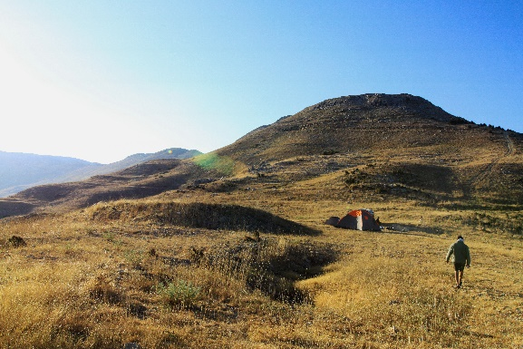
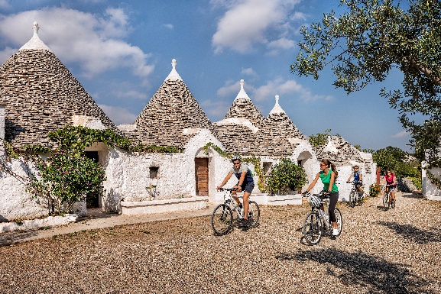
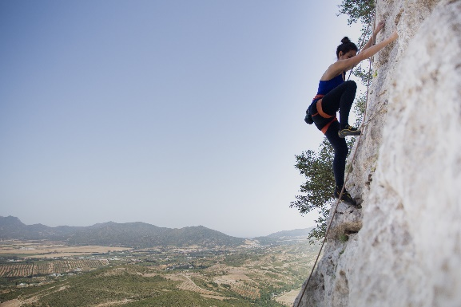
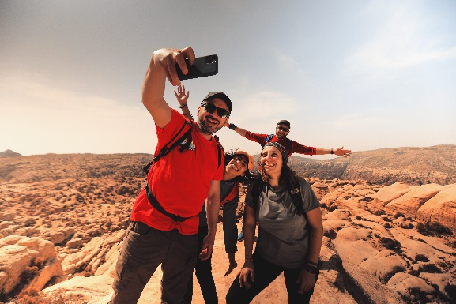
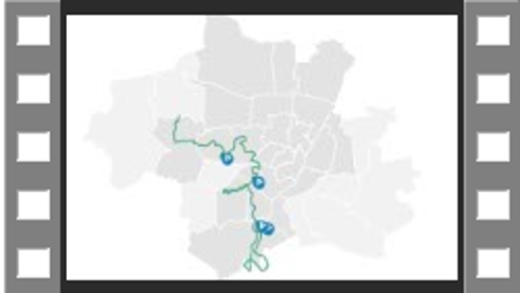
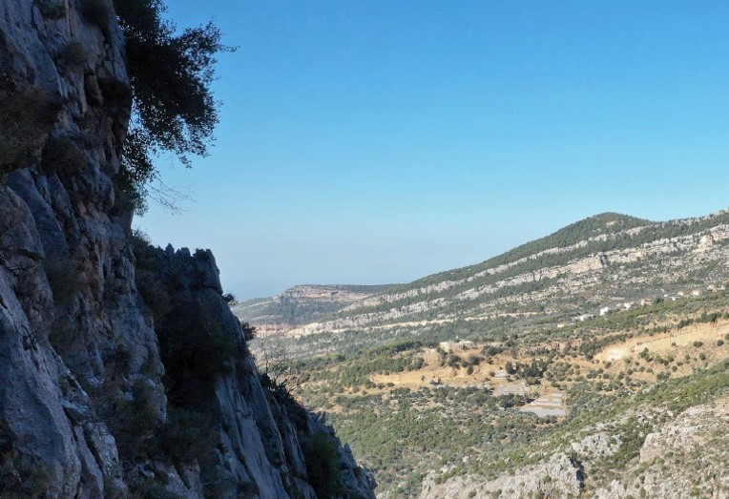
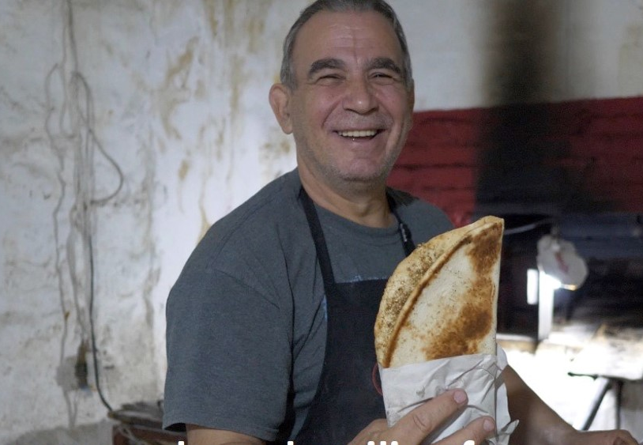
2. Picture gallery and videos
Mediterranean Adventures
Picture gallery illustrating each destination’s sustainable adventure tourism activities, authenticity and local people
A set of videos, two per destination – one video presenting the destination and another one showing testimonials of local people

Slide 6
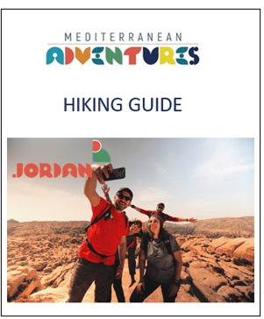
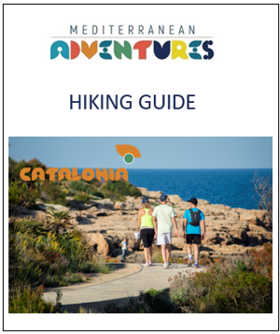
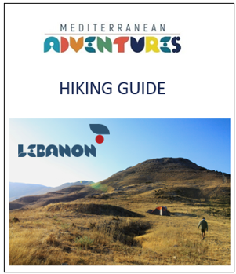
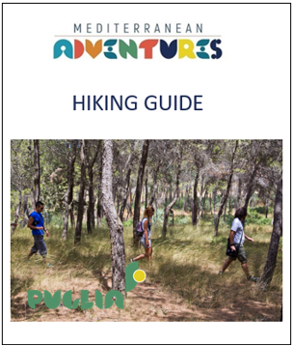
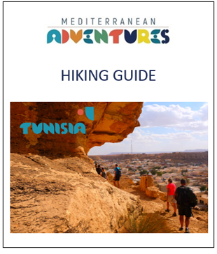
3. Hiking guides
Mediterranean Adventures
5 hiking guides – one for each destination.
Each guide provides information on one main hiking trail and five smaller trails.

Slide 7
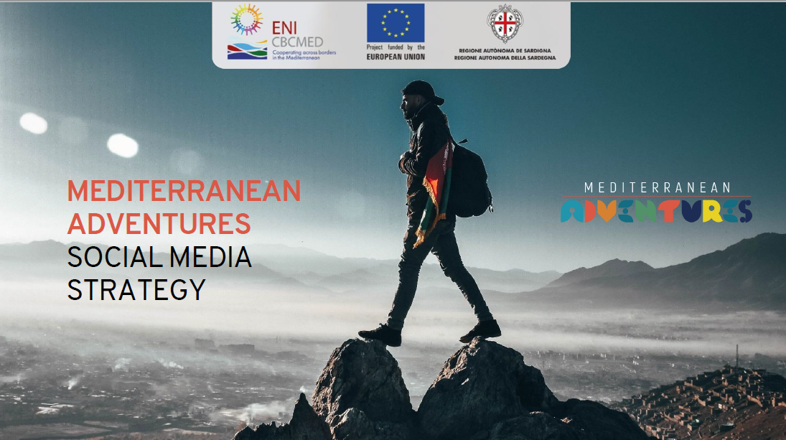
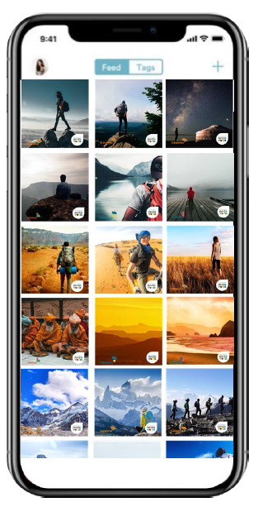
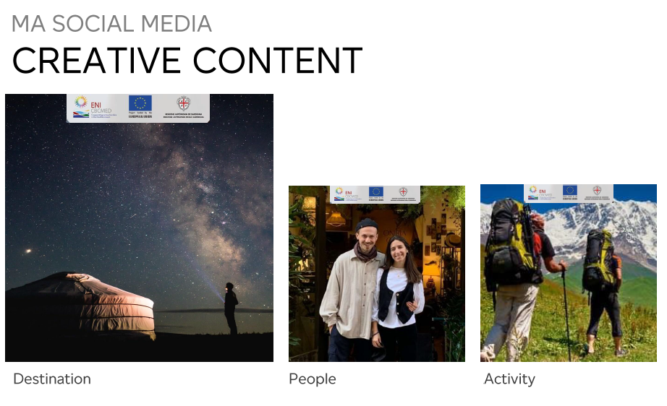
4. Social media
Mediterranean Adventures
Mediterranean Adventures social media campaign – starting in September 2022.
Creative content
It will target domestic markets and international markets, such as German speaking market, Norway, UK, USA, Australia.

Slide 8
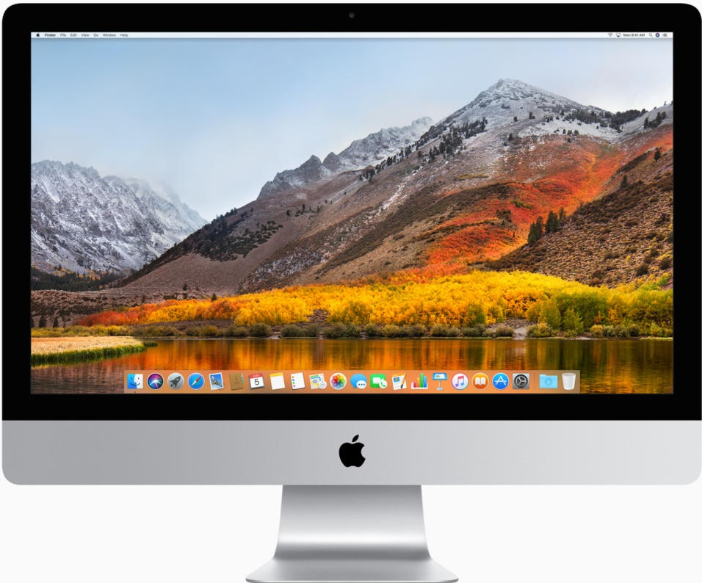
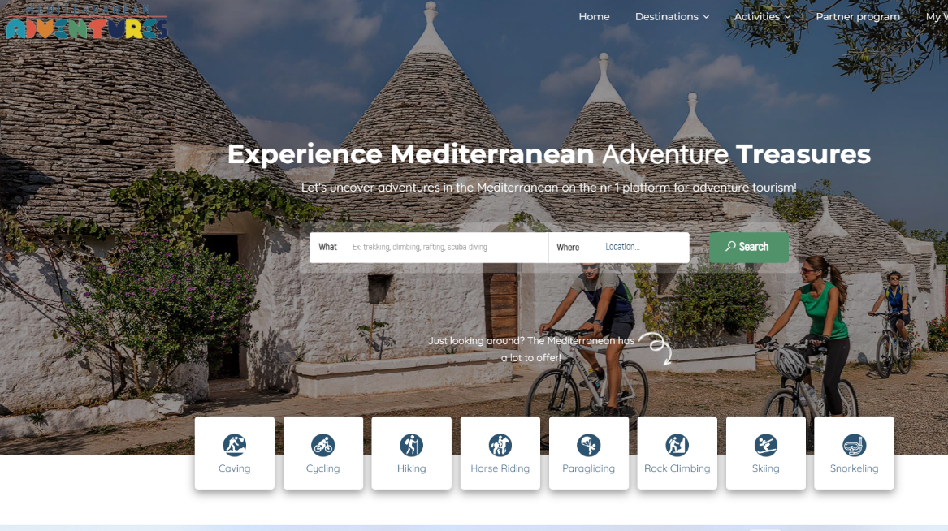
5. Web Portal
Mediterranean Adventures
Mediterranean Adventures Web portal, providing the marketing content and a member area.
www.mediterraneanadventures.org

Slide 9


