Slide 1
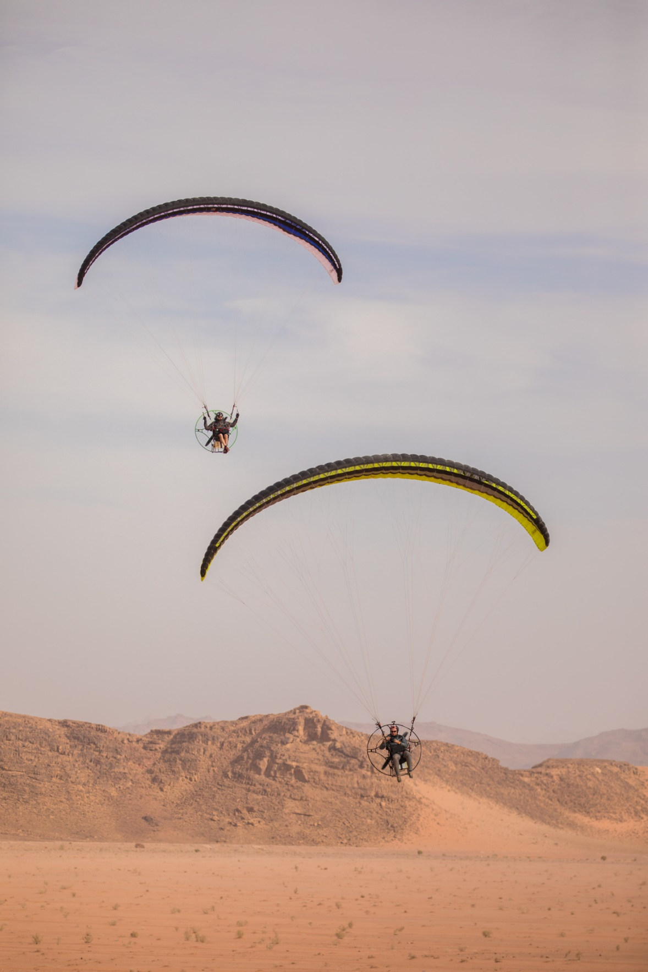
Session 4
Marketing tools & channels of the Mediterranean Adventures
Marketing Events
Lina Al-Khaled
MEDUSA Marketing Coordinator

Slide 2

Adventure Global Travel Summit
When and How to Join
MEDUSA project involvement
  MEDUSA destinations teams
  Tour Operators from MEDUSA Destinations
  (2 per destination)
Tour Operators Selection Process
  MEDUSA project will issue a tender for selecting interested participants from 5 destinations around 2nd week of August
  Tour Operators offering at least one adventure tourism programme, including a 2 overnight stays itinerary or one full day adventure tourism programme.
  MEDUSA project will cover participation and accommodation expenses

Slide 3

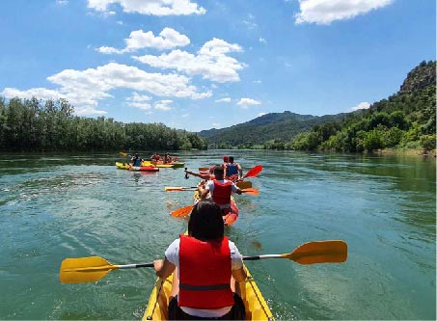


FAM trips in the MEDUSA Destinations
International FAM trips
(15 people):
Puglia
Catalonia
Jordan
Local FAM trips
(25 people):
Tunisia
Lebanon
Who is invited?
Tour Operators and Travel media from Target Markets (UK, US, Germany, France, Norway)
Target Dates:
October – November 2022
5 days/4 nights
Selection process?
FAM trip details will be announced mid September
A tender will be issued by project to solicit eligible participants
Details of participation will be complete after the ATWS 2022

Slide 4
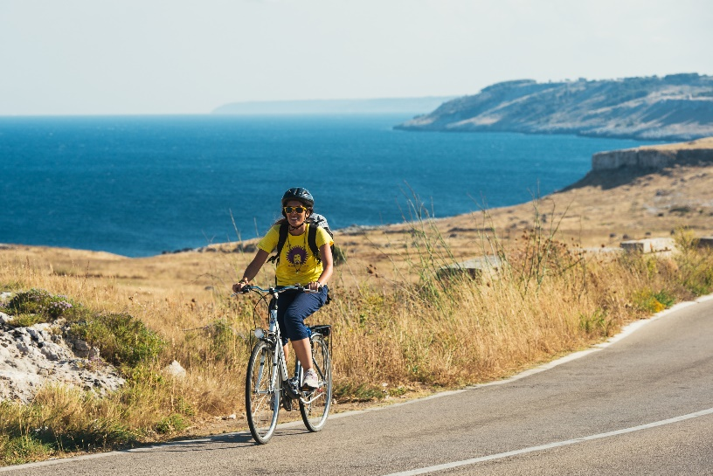
Puglia Study Tour
Marketing & Product Education, Period of October 24-31, 2022
WHO?
Service Providers from the MEDUSA destinations that have answered the call for participation and have met the eligibility criteria.
PURPOSE:
Learn about good practices in adventure tourism product development
Explore cross border co-creation opportunities
Learn more about adventure product marketing techniques
Create linkages with like-minded professionals and expand your business outreach

