Slide 1
Session 3 The Brand: Mediterranean Adventures
Lina Al-Khaled
Project Leader – Jordan
Marketing Coordinator MEDUSA Project

Slide 2
What are the Mediterranean Adventures?
Brand, Logo & Definition
The Mediterranean Adventures stand for sustainable adventure tourism products and experiences reflecting the authenticity, natural and cultural highlights of the 5 unique MEDUSA destinations Catalunya, Puglia, Jordan, Lebanon, Tunisia.
Mediterranean Adventures is an identity for local tourism businesses and local communities that helps to raise their competitiveness and generate benefits for all of them.
It promotes mainly soft adventure tourism activities, products and soft mobility options such as hiking, biking or trekking and cultural local experiences.
Slogan:
Experience the Mediterranean Adventure Treasures!

Slide 3
Mediterranean Adventures
Target Soft Adventure Activities
Top 5
Other

Slide 4
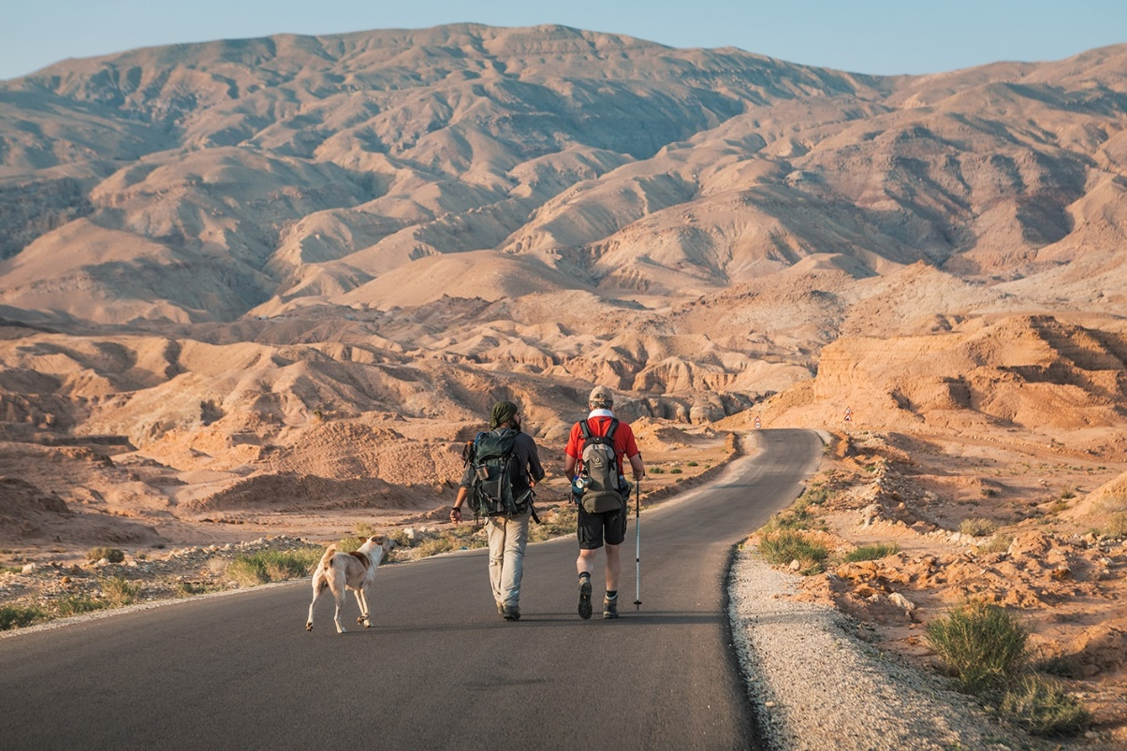
Mediterranean Adventures
Flagship Products
Draw the attention of potential visitors to the destination
Attract a special target group to the destination
Market the core characteristics and authenticity of the destination, as well as – of course – to market the destination itself.
Being a well-established tourism product, reflecting the authenticity, natural and cultural highlights, tourism value chain, and sustainable infrastructure of the destination.
For the Mediterranean Adventures long distance trails have been identified as “the” sustainable adventure tourism flagship products.

Slide 5
Mediterranean Adventures
Flagship Products in MEDUSA Destinations
from Tamazret to Douriret

Slide 6
The MEDUSA destinations and their flagship products are jointly positioned and recognized as one of the most diverse sustainable adventure tourism destinations on the international sustainable tourism market, standing for cultural and natural diversity, richness and authenticity, and are famous for their Mediterranean Art of Living.
One Vision ⃝ One Brand ⃝ One Marketing Approach

Slide 7
Working in partnerships
Market the Mediterranean Region under one umbrella brand
Private Businesses
Tour Operators
Service Providers
Marketing Stakeholders
National DMOs
Local DMOs and NGOs

Slide 8
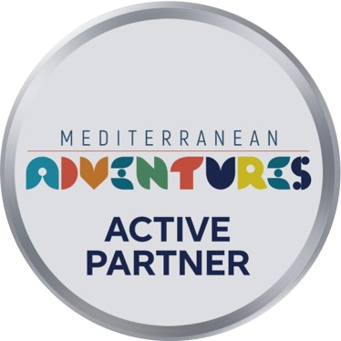
Eligible Private Sector Businesses
Brand at the core of all marketing activities and behavior
Tour Operators and Service Providers from the MEDUSA destinations - 7 key criteria:
Territorial registration
Visible Adventure Tourism offer
Adventure Tourism Programme in place
Integration of local communities
Applying sustainability
Soft Adventure tourism activities
Promoting the authenticity of the Mediterranean
Online & Offline

Slide 9
Why Partner with Mediterranean Adventures?
Stronger market positioning on the international travel market through joint marketing activities!
Being recognized as a sustainable adventure tourism operators, service provider or DMO in the Mediterranean.
Boosting your business reputation through co-marketing and branding
Having access to broader and more specialized international target markets.
Being part of a network of sustainable adventure tourism businesses and finding the right partners to create joint cross-border products and marketing activities.
Direct promotion of your offerings through the Mediterranean Adventures web portal: www.mediterraneanadventures.org

