Slide 1

MEDITERRANEAN
ADVENTURES IN PRACTICE
28.7.2022

Slide 2
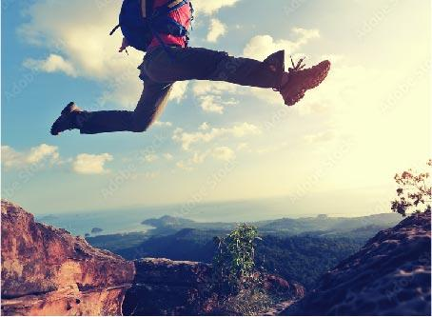
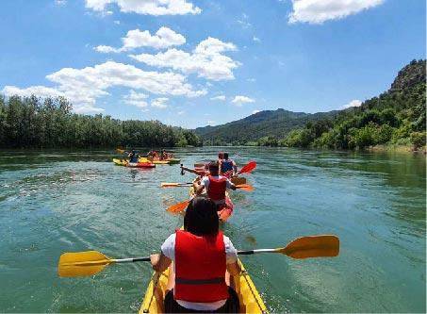

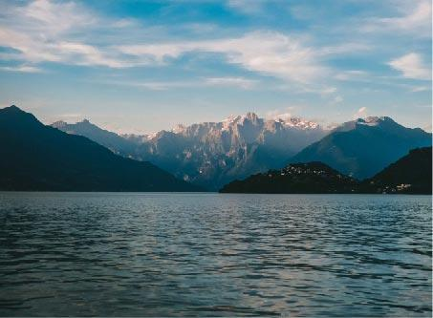
MEDUSA Project update
What is “Mediterranean Adventures”?
What do we want to achieve today?

Slide 3
AGENDA
WEBINAR
SESSION 1: Sustainable ADVENTURE Tourism in the MEDUSA Destinations
SESSION 2: MARKETING GOOD PRACTICES IN ADVENTURE TOURISM
SESSION 3: Introducing the “Mediterranean Adventures” Brand
SESSION 4: Marketing Tools & Channels & Events of the MA
Questions & Answers
Next steps
Notes:
OBJECTIVES
• Provide adventure tour operators and service providers in the MEDUSA destinations with guidance on marketing
practices to promote their business
• Inform about the MEDUSA project marketing activities
and tools.
AGENDA HIGHLIGHTS

Slide 4
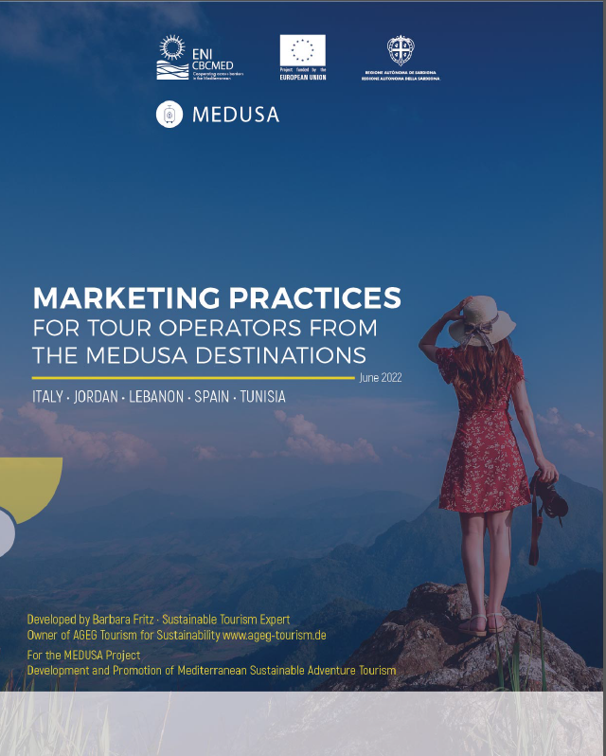
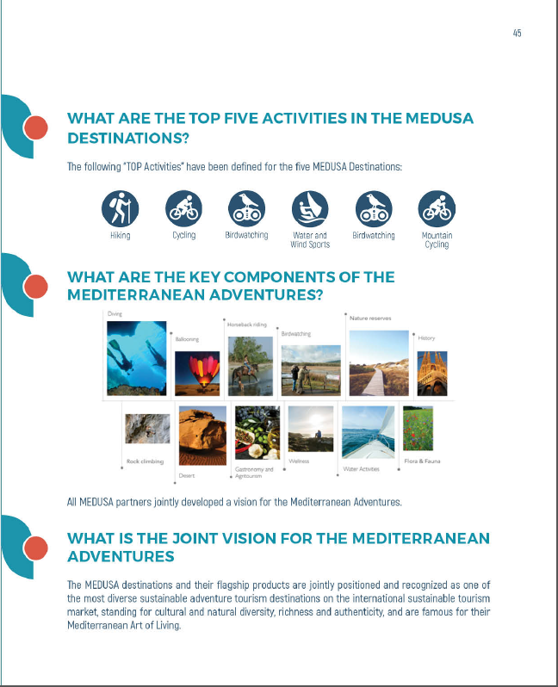
WEBINAR
BACKROUND INFORMATION FOR PARTICIPANTS
Handbook on Marketing Practices
Selection of marketing platforms
Good practice examples
Marketing and branding guidelines
Marketing events
& Power Point Presentations will be send out to participants by next week!

