Slide 1
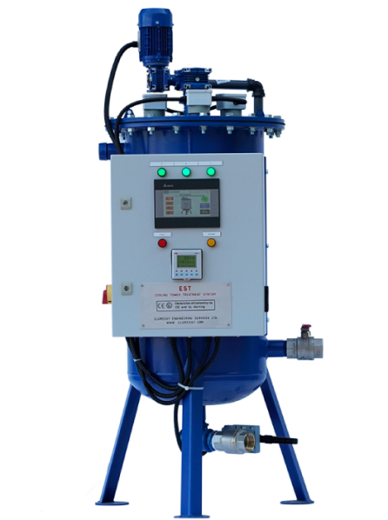
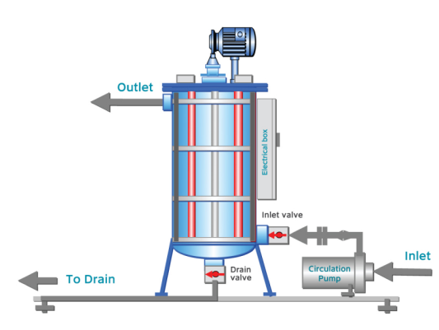
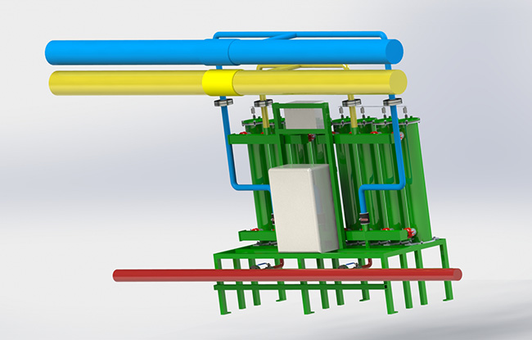
Water
Electro-chemical treatment of Cooling tower water and blowdown minimization
water savers
To use water efficiently in the cooling tower system, the cycles of concentration must
be maximized. This is accomplished by minimizing the amount of the required blowdown that normally happens due to increase of salts concentrations. Treating the water reduces the make-up water demand. The degree to which the cycles can be
maximized depends on the water chemistry within the cooling tower and the water
chemistry of the make-up water supply. The treatment of the cooling tower water also helps the system in corrosion protection and microbiological growth and contamination.
Potential use in hotel industry
Cooling tower blowdown minimization
Disadvantages | Advantages
Additional professional water treatment requirements | Solves cooling tower problems stemming from algae, corrosion and scaling
 | Reduces maintenance

Slide 2
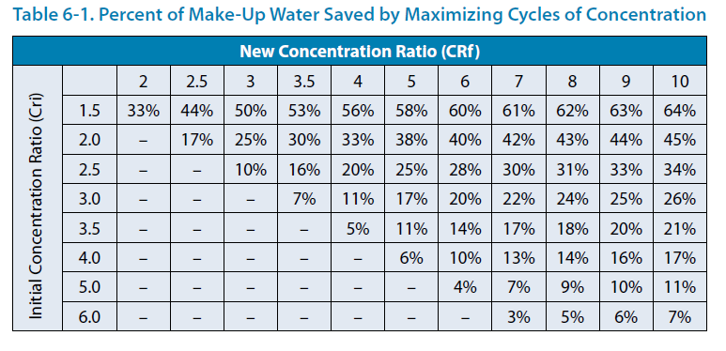
Water
Electro-chemical treatment of Cooling tower water and blowdown minimization
water savers
Part 2 –Performance, Case studies
CASE A : UET improved the efficiency of the air-conditioning system for the surgery building of a major Israeli hospital complex, which was using soft water and salt to tackle scale build-up in the water cooling system. This product is designed for pre-treatment of feed water to reverse-osmosis systems
And eliminated the problems of scale build-up, increased their water conductivity, and reduced their use of water softeners and salt.
Total Water Savings were about 45% and chemical were not added any more.
CASE B : Electrochemical Treatment Unit Installed in
Central Ohio Chemical Processing Plant. The Elgressy Electrochemical Scale Treatment System (EST) was installed on one (1100 T.R) of the two cooling towers on site. Although a direct year to year comparison is difficult because of load changes, it is clear that the EST
system is saving water with the increase in cycles of concentration. It was estimated that the water savings was in excess of 2.2 million gallons if all operating conditions were the same
Part 3 –Companies manufacturing/implementing the technology
Elgressy, https://www.elgressy.com/solutions/cooling-towers-treatment-est/
UET, https://www.uet.co.il/product/cooling-tower-system/

