Slide 1
Fashion! Emmerging Style and Design
Hani Mourad
16/17 Oct 2014

Slide 2
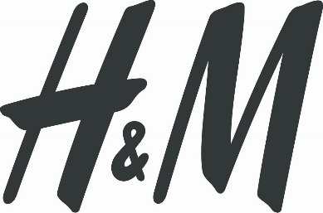
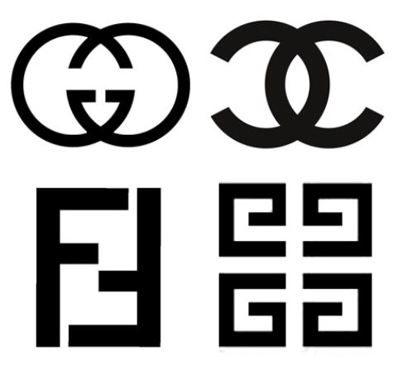
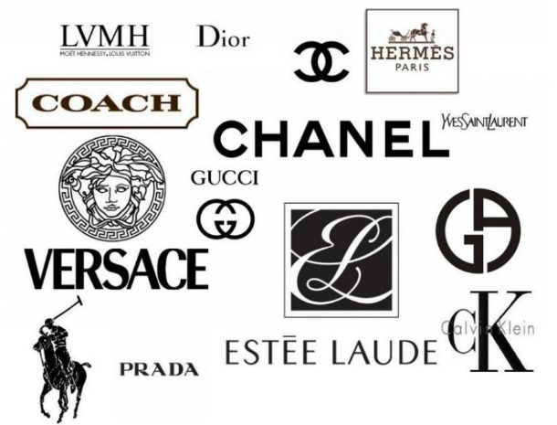
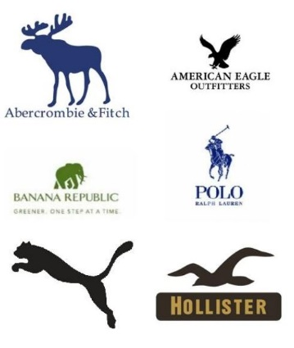
The Picture Now
16/17 Oct 2014

Slide 3
The Picture Now
There are mainly two fashion groups:
The HUGE retailers (H&M, Zara etc)
The BIG brands (Fendi, Gucci, Dior etc.)
And very little in between
16/17 Oct 2014

Slide 4
Difficult market penetration for existing companies
As in comparison to the big producers, The SME’s have to face:
Change of Mindset / Subcontractor to Producer
Big competition
Difficult Sourcing
Expensive product development
Lack of technology
PRICE
16/17 Oct 2014

Slide 5
What can SME’s do in this cut throat market?
Stay small and keep on working as subcontractors!
OR
Carve out a “niche” market for themselves
Get all the help they can through SME support programs
Use unconventional means to surmount sourcing problems
16/17 Oct 2014

Slide 6
What are technical fibers?
The Technology
A “NICHE” Market
Microfibers: The technology behind microfibers is the size of the fibre. Microfibers are fibres that are less than one denier per filament or 100 times finer than a human hair.
Microencapsulation: The textile industry utilizes microencapsulation, a technology that uses microcapsules, which serve as tiny containers of substances. The substance, liquid or solid, is released to fulfil a specific purpose
Nanotechnology: One of the hottest trends in the fashion industry today is ‘nanotechnology,’ which is invisible to the naked eye but is utilized to increase the performance and the functionality of textiles.
Antimicrobial /Stain Repellent and Stain Release / Moisture Management / Heat Inducement Ultraviolet Protection OR A Bundling of Functionality
16/17 Oct 2014

Slide 7
A “NICHE” Market
So What Can All That Be Good For in Fashion??
Moisture Management
Heat Inducement
Ultraviolet protection
Stain repellent or resistant
16/17 Oct 2014

Slide 8
A “NICHE” Market
Developing “alternative” fashion and marketing channels
Addressing local community needs for modest clothing in Islamic society / Islamic Wear
Highlighting indigenous handicrafts in Fashion (Styles / Colors/ Embroidery and other local textile decorations)
Integrate marketing outlets in production (Producer/retailer)
Develop E-Commerce for the above
16/17 Oct 2014

Slide 9
A “NICHE” Market
SME and MSE support programs
Research and development support
Technical Support
Support in marketing efforts / Advertising
Support in renovating machinery
Support in using new technology
16/17 Oct 2014

Slide 10
A “NICHE” Market
The use of unconventional means
Increase your competitive advantages through developing collections
Create contacts with good textile manufacturers / Use of stocks
Increase your knowhow through making maximum use of experts
Travel, see and copy
16/17 Oct 2014

Slide 11
A “NICHE” Market
Invest in Human Resources
Making a cheaper product is not the only way to compete
Change Must Come
Take a Ride on the New Wave
16/17 Oct 2014

Slide 12
The 2007-2013 ENPI CBC Mediterranean Sea Basin Programme is a multilateral Cross-Border Cooperation initiative funded by the European Neighbourhood and Partnership Instrument (ENPI). The Programme objective is to promote the sustainable and harmonious cooperation process at the Mediterranean Basin level by dealing with the common challenges and enhancing its endogenous potential. It finances cooperation projects as a contribution to the economic, social, environmental and cultural development of the Mediterranean region. The following 14 countries participate in the Programme: Cyprus, Egypt, France, Greece, Israel, Italy, Jordan, Lebanon, Malta, Palestine, Portugal, Spain, Syria (participation currently suspended), Tunisia. The Joint Managing Authority (JMA) is the Autonomous Region of Sardinia (Italy). Official Programme languages are Arabic, English and French (www.enpicbcmed.eu).
This presentation has been produced with the financial assistance of the European Union under the ENPI CBC Mediterranean Sea Basin Programme. The content of this document are the sole responsibility of Beneficiary or Project Partner and can under no circumstances be regarded as reflecting the position of the European Union or of the Programme’s management structures.
27th February 2014

