Slide 1
Session 4 Marketing tools & channels of the Mediterranean Adventures
Web Portal
WideOyster Team
MA Web Portal Developers

Slide 2
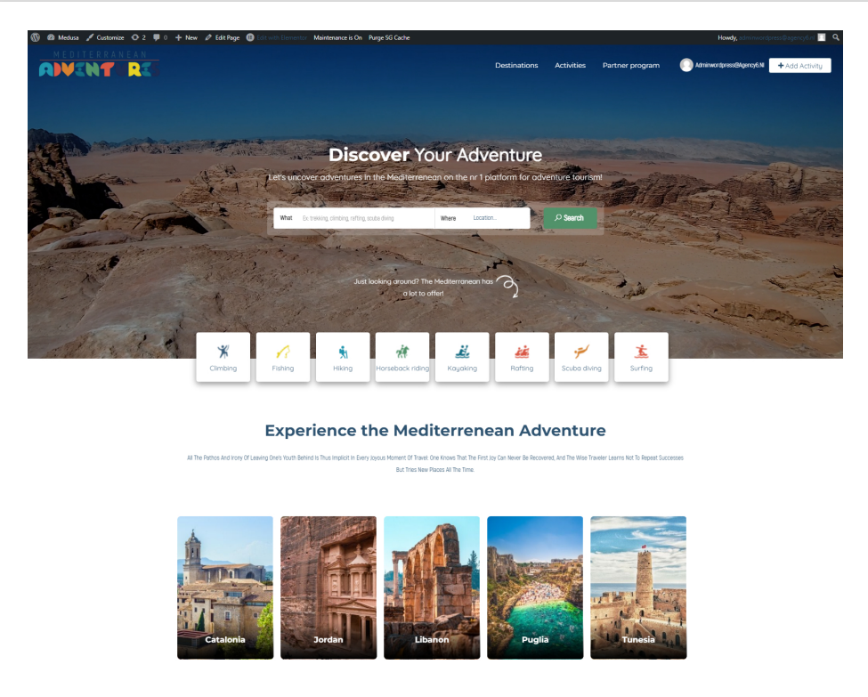
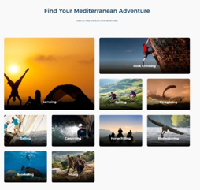
The Mediterranean Adventures Web Platform

Slide 3
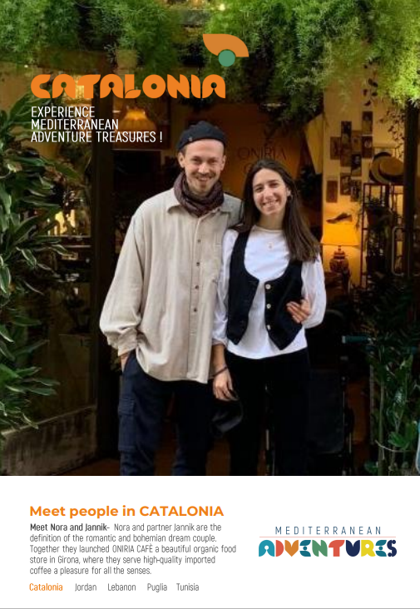
Join the Mediterranean Adventures Web Platform Community
www.mediterraneanadventures.org

Slide 4
Why Join the Mediterranean Adventures Platform
Higher visibility on the international adventure travel market
Boosting your business reputation through the power of inspirational storytelling
Recognition as a sustainable adventure tourism operators or service provider partner of in the Mediterranean, supporting sustainable tourism in less known destinations all year round
Direct reservation of your products through direct linkage with you (no online payment)
Having access to broader and more specialized international target markets.
Being part of a network of sustainable adventure tourism businesses and finding the right partners to create joint cross-border products and marketing activities.
Access to information repository (destination reports, benchmark studies, branding content, photo &video gallery).

Slide 5
How to Register
Tour Operators and Service Providers
Create a Sign In profile
Watch the tutorial video / read instructions on platform use
Read the Rules and Regulations
Use the online registration form to fill in your business information and upload necessary documents
Submit your registration request
We will reply to you within 4 business days

Slide 6
Access for Registered Eligible Accounts
Invitation to Join the Platform
Upload a product/service that you would like to promote and sell on the platform
Sales will be conducted through linkage to your specified e-mail address or other means
You can make use of existing photo gallery for your online or offline activities
You can download the branding guide and start using the MA logo as directed
You can use the Partner Badge in your online and offline promotional material, ensuring conformity with branding guidelines
You can make use of the existing material and content to promote your destinations
In the future you will be able to position your product/service on the map
Link yourself to the hiking trails if applicable22

Slide 7
Technical Requirements and Approval Process
Invitation to Join the Platform
Official and valid registration in MEDUSA destinations
Adventure, Experiential tourism offers
Liability Insurance
Cancelation Policy
Sustainability certifications (obtained or in process)
Applications to be submitted online

Slide 8
Development Timeline
Soft launch & Trial - August 2022:
5 eligible companies from each destination will be selected during August to register and upload their packages
Official Registration open for other providers - September 2022
Application will be done online with manual approval until end of 2022

