Slide 1
SESSION 1: Sustainable Adventure Tourism in the MEDUSA Destinations
Barbara Fritz
Sustainable Tourism Expert
CEO AGEG Tourism for Sustainability

Slide 2
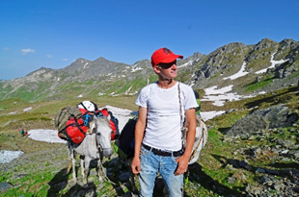
SUSTAINABLE ADVENTURE TOURISM
What type of Adventure Tourism is sustainable?
Soft types of adventure tourism Hard types of adventure tourism
Notes:
Not every type of adventure tourism is really sustainable and brings benefits and economic growth to local communities without harming the environment.
Soft adventure tourism types using slow mobility options such as hiking, biking, trekking etc. and
Use sustainable tourism infrastructure such as trails, signposting etc
and involve many local tourism stakeholders in the tourism value chain (e.g., B&Bs, local guides, small local restaurants, incoming operators etc. and create income for the local communities
In contrast, less or unsustainable practices often only generate benefits for a very small group of beneficiaries and cerate negative impact for the environemnet

Slide 3
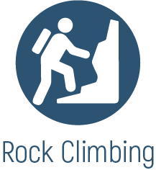
Sustainable Adventure Tourism Activities
MEDUSA Destinations
Notes:
That’s why the following sustainable adventure tourism activities have been selected to be promoted under the Mediterranean Adventures Brand

Slide 4
What does the Soft Adventure Tourist look for?

Slide 5
TARGET GROUPS
MEDUSA Destinations
Notes:
Whats the emotional profile of the sustainable traveller?
Activley seeking for new experiences to enrich his knowledge
Geographically
Socio – demographically
Travel Behaviour
Groups of young individuals or hiking, biking, or trekking clubs
Adventure tourist
Young domestic travelers (average age: 18-30 years)
Sportive, interested in local traditions, culture and nature, sustainability -oriented and looking for authenticity
Young travellers, hikingers, adventureres (average age 18-30)
Mediterranean lovers with hiking, biking and trekking interest
Well-educated and financially well-positioned (average age 35-65 ) European traveller
Active seniors 50-70
International hikers, bikers and trekkers always looking for new destinations and challenges ,nterested in traditions and cultural encounters

Slide 6
TARGETS MARKETS
MEDUSA Destinations
Domestic markets in the 5 countries
German-speaking travel market: Germany, Switzerland, Austria
France, Norway, United Kingdom
USA & Australia

Slide 7
What is the USP of 5 MEDUSA Destinations?
Cultural diversity and natural beauty
Spectacular landscapes
Different climate zones
Authentic traditions
Unique cultural landscapes and practices and
Historical sites
Connected through the history, shared values, the Mediterranean art of living
The warm hospitality of the people
That all in all, makes the 5 MED destinations a treasure chest among tourism destinations.
Notes:
What can the sustainable adventure tourist find find in the MEDUSA destinations
What makes the Mediterranean region so special?
What is authentic and unique for the 5 MEDUSA Destinations :Tunisia, Puglia, Catalonia, Lebanon and Jordan?
What can you find they you would not find in any other sustainable adventure tourism destination?
What is the USP - the Unique selling proposition of this 5 destinations?
It’s the combination of….

Slide 8
MEDUSA DESTINATIONS
Unique Selling Proposition
&
Sustainable Adventure Tourism Activities
Notes:
Lets have a look on the sustainable tourism highlights of each destination

Slide 9
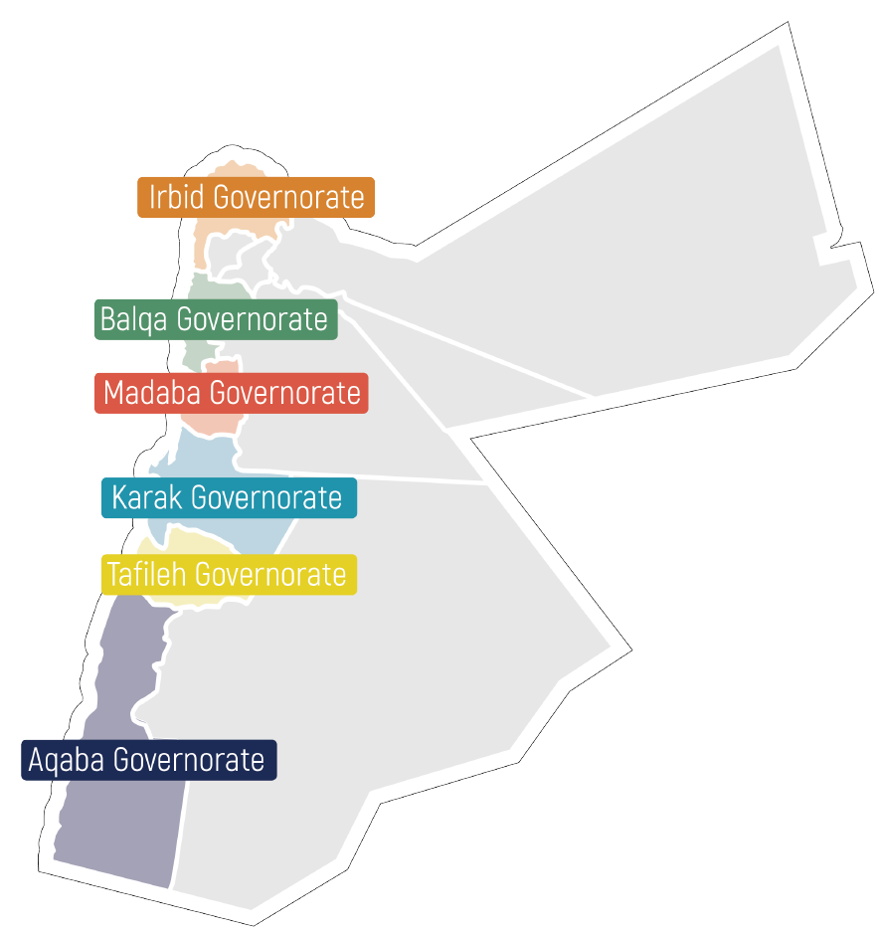
All year round:
Top Adventures:
Highlights:
Diverse landscapes – from the mountains, desert to the forests and coastline
Great infrastructure for long-distance hiking and biking trails
Rich cultural heritage with many religious and Graeco-Roman sites, Medieval Arab architecture, and Petra - the ancient city of the Nabatans
Authentic living culture of Bedouin tribes and variety of local craft products as well as outstanding culinary experiences
Notes:
6. Pilot destinations
All year arounds
Top Adventures
Hiking and Trekking
Cycling and Mountain
Biking
Canyoning and Wet Canyoning
Rock Climbing and
Abseiling
Birdwatching

Slide 10
Notes:
Inspiring desert landscapes, world heritage sites, a well-managed network of protected areas and its cultural diversity make Jordan a sustainable adventure tourism destination.
Jordan has a Strong system of protected areas with ecotourism infrastructure: 13 protected areas, including one wetland reserve conserving a unique oasis, many small forest nature reserves with mountainous terrain, one canyon reserve with freshwater streams, the biggest nature reserve (Dana) sweeps down in a series of mountain ridges from a 1,500m high plateau to the desert plains, and the Wadi Rum desert wilderness with huge mountains and broad sandy wadis.
Also, a Rich cultural heritage: 6 World Heritage Sites, many religious sites (e.g. Mount Nebo, Sea of Galilee), Roman, Greek and Medieval Arab architecture, and the ancient Nabataean city of Petras.
Jordan’s pilot areas offer unique adventures, including long-distance hiking and cycling, canyoning and local Bedouin lifestyle experiences.

Slide 11
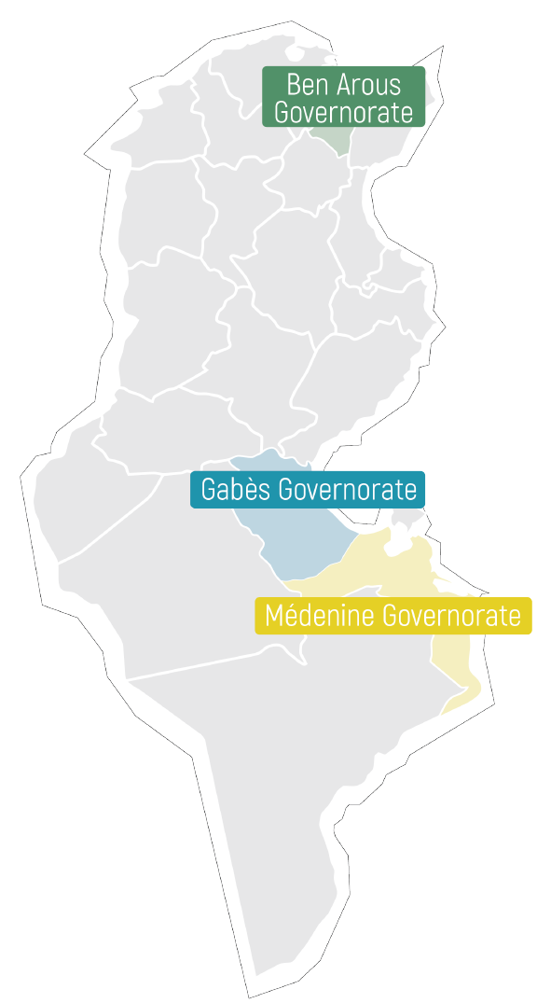
All year round:
Top Adventures:
Highlights:
Diverse nature and landscapes – 1300 km of the coastline, the forested coast, mountains and desert
Rich cultural heritage with influences of Romans, Phoenicians, Islamic architecture, indigenous Berber architecture
17 National parks
Most of protected areas are wetland sites, there are 42 RAMSAR sites in Tunisia
800 hotels, plus numerous guest houses, and unique stays in the south in cave dwellings (troglodytes and Ksour)
Notes:
3 Pilot destinations, including Gabesch and Medinine belonging to the authentic adventure tourism destination Dahar
All year round destination
Top Adventures
Hiking in the Dahar mountains
Cycling and Mountain Biking
Birdwatching
Running
Paragliding/Parasailing

Slide 12
Notes:
Tunisia is a destination with outstanding Cultural heritage, arts and crafts and incredible extremes of landscape – forested coastlines, Saharan sand seas, the Atlas Mountains, 1300 km of coastline and protected areas.
Besides its diverse natural beauty, Tunisia is among the world´s premier areas for olive cultivation, and other agriculture like pomegranates, wine, and dates.
Plus, the Matmata are is offering to discover the Berberian culture and heritage with troglodyte homes dug into the rocks and hidden passageways.
Pilot areas in Tunisia offer diverse adventure activities, such as hiking, cycling and mountain biking, several birdwatching opportunities as well as running or paragliding.

Slide 13
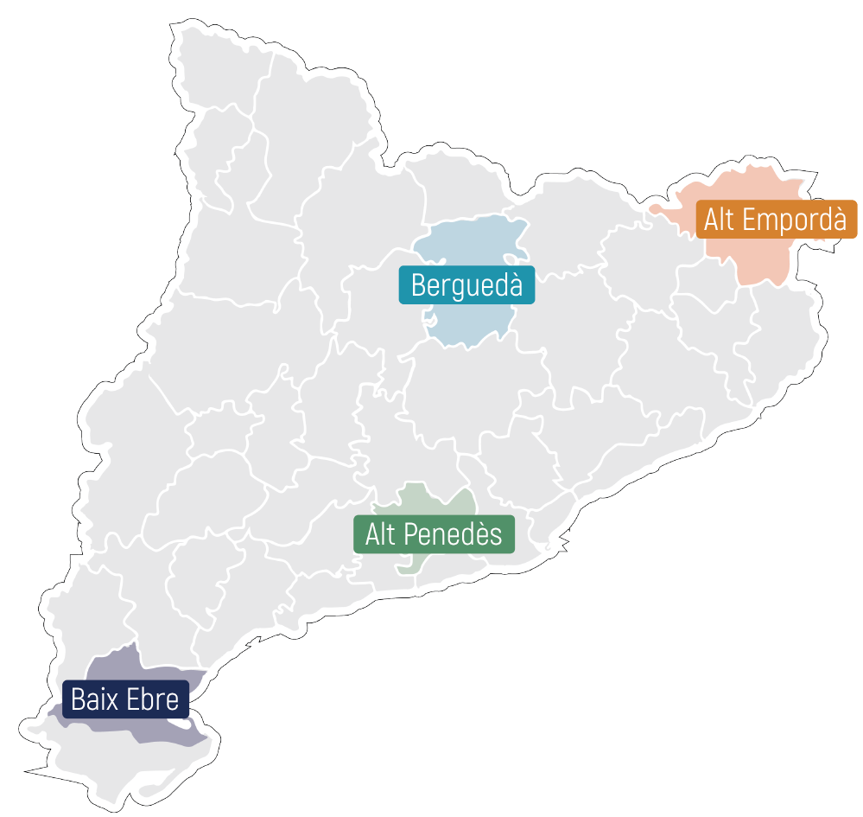
All year round:
Top Adventures:
Highlights:
Diverse landscapes from the coastline to the high mountains up to 3000 m
Well established soft adventure infrastructure – 5000 km of signposted long-distance hiking trails
1 National park and 14 Natural parks
580 km of coastline
2 UNESCO Geoparks, 2 UNESCO Biosphere Reserves
9000 km of signposted hiking paths
2400 rural tourism accommodation
Notes:
4 Pilot destinations
All year around destination
Top Adventures:
Hiking
Cycling and Mountain biking
Birdwatching
Water and Wind sports
Highlights:

Slide 14
Notes:
Catalonia is a diverse region with the high alpine Pyrenees, extensive green forests in the low mountain ranges and agriculturally-used plains as well as its wild and rocky coast, sandy beaches, and 580 km of coastline.
It is Full of culture, culinary experiences and traditions, some of them declared Immaterial Heritage by UNESCO, as well as traditional agriculture of wine, olive oil, almonds, and culinary traditions, preserved medieval villages, old monasteries, and ancient archaeological sites.
One of the largest wetlands on the Mediterranean Coast is also here –the Ebro Delta
As well as great sustainable tourism infrastructure, plus Green ways – a network of accessible paths, and Vies Braves: network of marine and open water routes used for sporting, leisure, and educational activities
Each pilot area in Catalonia has great offers – from one of the most important skydiving centers in the worlds, hiking and cycling through vineyards, birdwatching in Ebro delta to mountain biking, climbing and paragliding (in Bergueda).

Slide 15
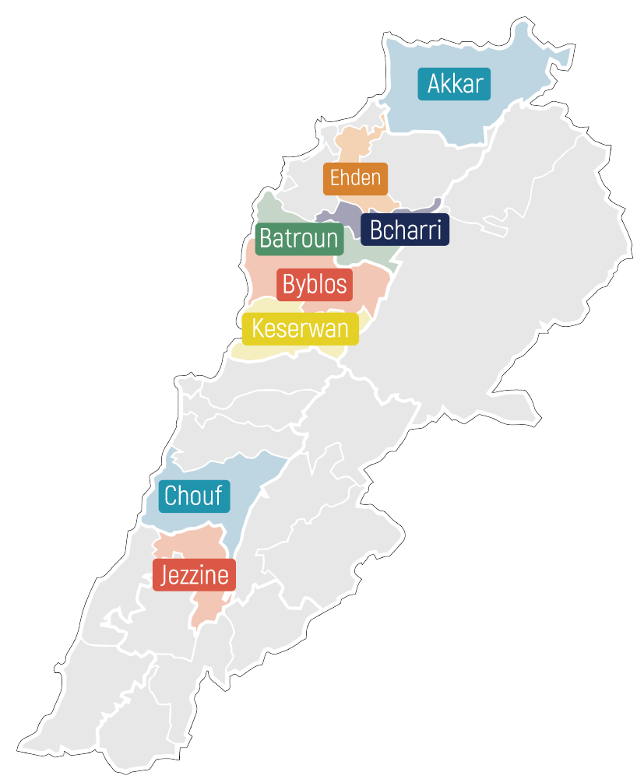
All year round:
Top Adventures:
Highlights:
Diverse landscapes from coast to high mountains
A network of authentic hiking trails based on ancestral footpath network
470 km Lebanon Mountain trail from north to south
15 nature reserves
Jabal Moussa UNESCO Biosphere Reserve
350 accommodation facilities, including monasteries
Notes:
Top Adventures
Hiking and Trekking
Camping
Alpine Skiing
Rock Climbing
Biking

Slide 16
Notes:
The mix of Mediterranean coast, rugged mountain peaks, ancient cedar forest and its diverse cultural and culinary experiences makes Lebanon an insider’s tip.
Besides its stunning landscapes, Lebanon also has rich cultural heritage: ancient cities, with architecture going back to the Romans, Phoenicians, Ottomans, and French, as well as post-independence developments.
Plus, the Lebanese food is considered one of the most popular Middle Eastern cuisines and there is a great variety of traditional handicrafts practiced still today.
Each pilot area has great adventure tourism offers, with numerous hiking opportunities including in nature reserves, alpine skiing in the mountains, rock climbing, caving and more.

Slide 17
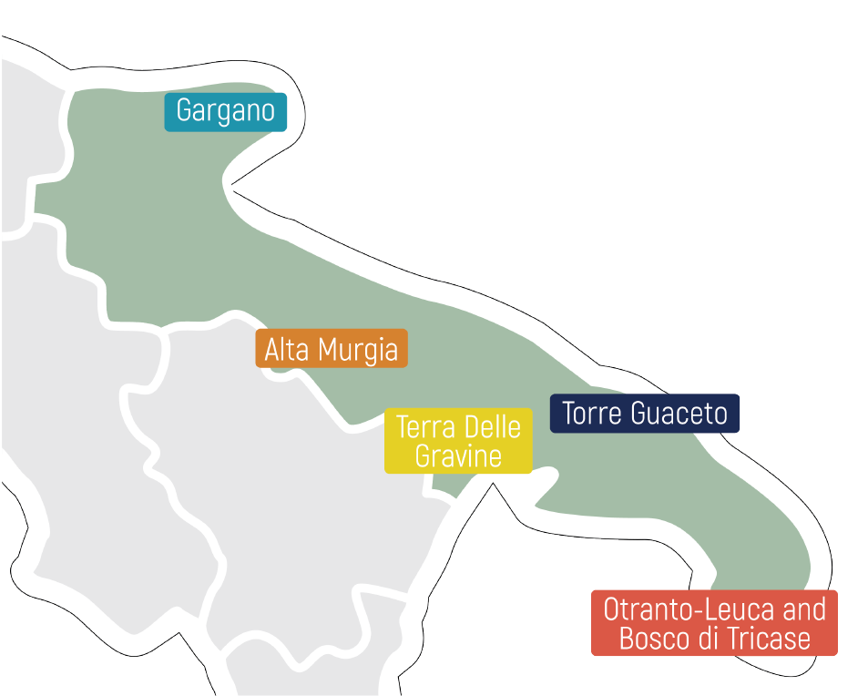
All year round:
Top Adventures:
Highlights:
Extensive network of hiking paths, including ancient routes
Caving options from north to south
One of the clearest seas in the Mediterranean
Strong local culture with authentic architecture -Trullis (drystone huts)
Apulia is part of Natura 2000 network
2 National Parks
18 Regional Parks
3 Marine Protected Areas
16 State Reserves
9 official walking & 6 cycling routes
More than 1000 accommodation units
Notes:
5 Pilot destinations
Top Adventures
Hiking and Walking
Cycling
Horseback Riding
Caving
Scuba Diving and Snorkelling
Birdwatching
Hightslights

Slide 18
Notes:
Puglia is a region of extraordinary colours and beautiful diversity of nature, culture, history, and breath-taking landscapes. It’s bordered by two seas, the Ionian and Adriatic, with 800 km of coastline.
Besides its sceneries and landscapes, Puglia also has fascinating Local architecture, traditions, and products. Such as Trullis (traditional drystone huts) enclosed by vineyards and olive groves, underground oil mills, and pottery and fishing villages, where traditions and customs are still upheld today.
Also, an outstanding Authentic culinary offerings: 10,000 local restaurants of which 2,000 have an excellence certificate, 1,000 farmhouses, 400 products with controlled and guaranteed origin and more.
Each pilot area has great offers – scuba diving and snorkelling in the Tremiti islands, cycling on the ancient rural paths, coastal hiking, numerous birdwatching opportunities and more.

Slide 19
MEDUSA Marketing Approach
Market the 5 MEDUSA Destinations and Pilot Destinations as Mediterranean Region under one umbrella brand!
Standing for Authentic, Sustainable Adventure Tourism!
Notes:
MEDUSA marketing approach: to market All this authentic cultural and natural highlights of the 5 Medusa Destinations and their pilot destinations and sustainable adventures tourism practices
As one region under one umbrella brand: the Mediterranean Adventures

